Slide 1
Council of Lutheran Women 2020 and 2021 Women of the Year

Slide 2
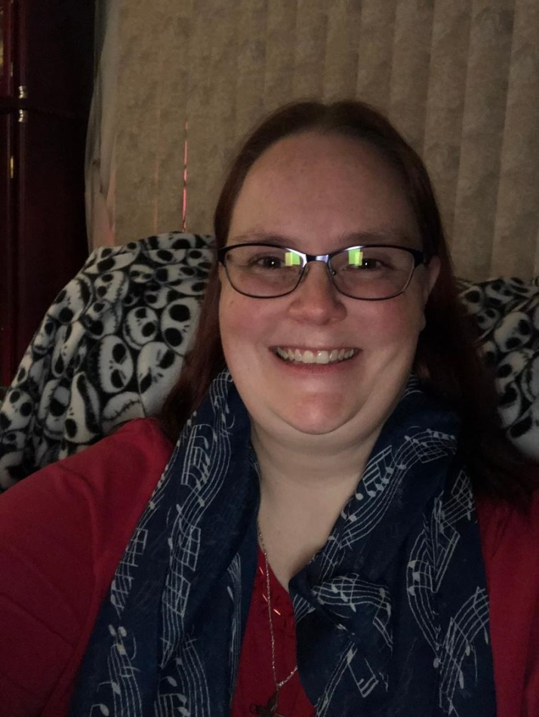
Jill Holls
Angelica, Allen Park
Jill never seems to tire of serving her Lord. She currently serves on the Christian Board of Education, teaches Sunday school, participates in book club, in the Altar Guild and Angelica's choir. She has sponsored and conducted fundraising programs. She was recently elected VP of the Congregation. She works tirelessly for the congregation allowing her passion to shine through.

Slide 3
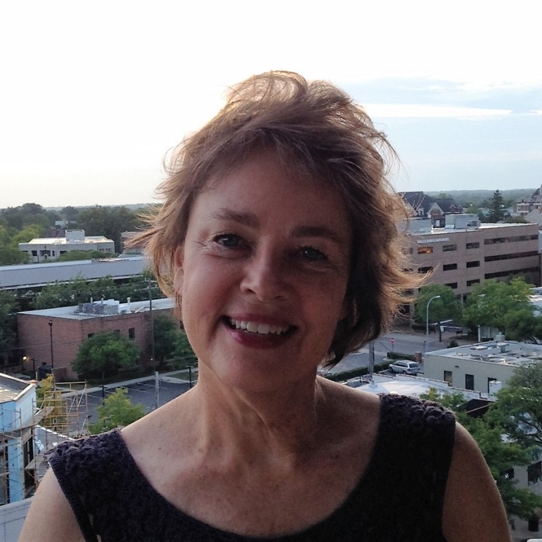
Debra Jo Elsholz
Ascension of Christ, Beverly Hills
Debra Jo is multi-faceted and generous with her time, treasures and talents. She is currently serving in various ministries: Shut-in visitation, Adult Fellowship Counter and Gardener. She has also been singing the Lord's praises as part of many various choirs, including the Detroit Lutheran singers.

Slide 4
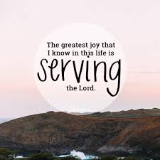
Letitia Body
Bethany Lutheran, Detroit

Slide 5
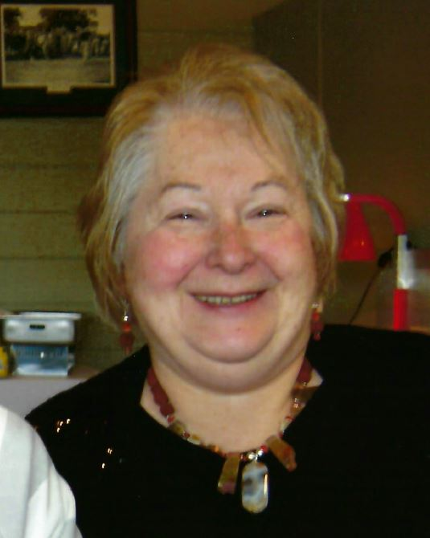
Carol Duff
Bethlehem, Roseville

Slide 6
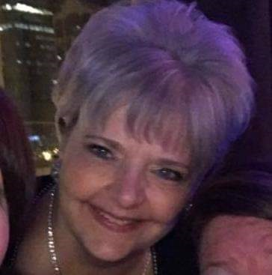
Debbie Cordray
Christ Our Savior, Livonia
There are many words and attributes that describe Debbie and her love for the Lord - kind, thoughtful, dependable, humble, just to name a few. She is one of those "unsung heroes" who is a hardworking, conscientious and diligent worker behind the scenes. Her willingness to be the feet, hands and voice God has called her to be is something we are all thankful for.

Slide 7
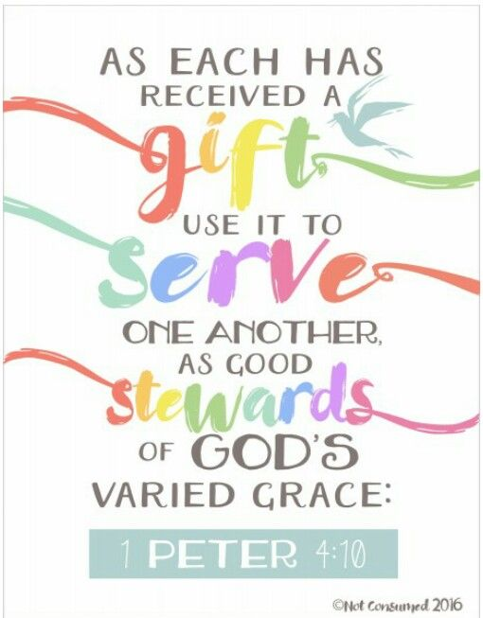
Carol Graf
Christ the King, Grosse Pointe Woods

Slide 8
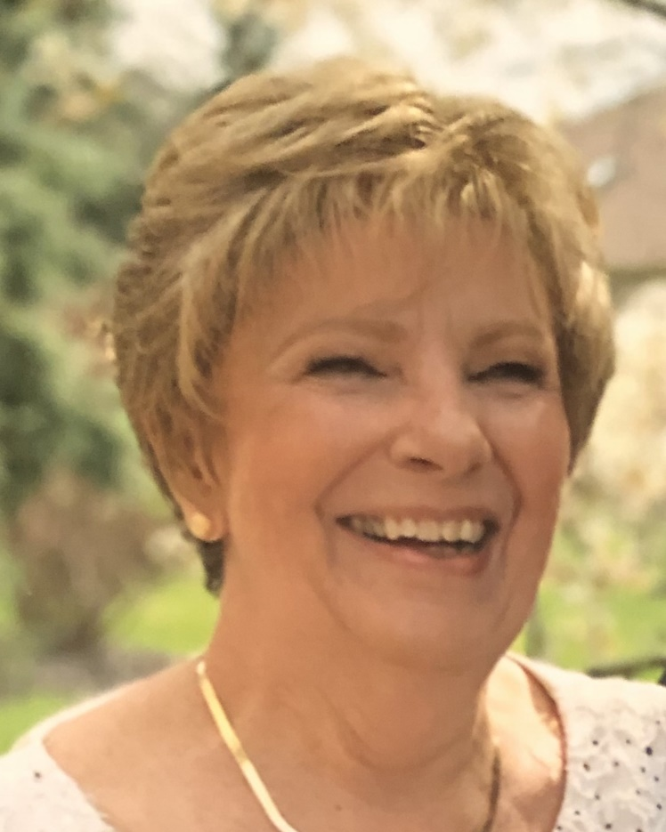
Jean Orvosh
Christ the King, Southgate
Jean has been a member of Christ the King for 54 years. In those years, Jean has volunteered for many ministries along the way. She has been a Funeral Lunch cook and hostess, Easter Vigil hostess, worked at the donation station, helps the church office with Administrative duties, is the hostess for the Good News/Discipleship class, a greeter, a prayer partner, and part of the Lunch Bunch group.

Slide 9
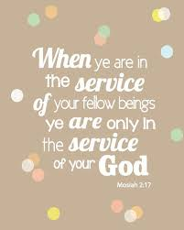
Suzanne Soltess
Lutheran Church of the Redeemer,
Birmingham

Slide 10
Jan Milz
Cross of Christ, Bloomfield
Jan is known for her gracious and willing "behind the scenes" service in many areas of ministry. She is an excellent seamstress and has manned many pleated table skirts for use at special church functions. She is always there to help set-up, serve and clean up for funeral lunches and special dinners. She sings God's praises as part of the choir. Her pleasant manner and special God-given talents are a blessing to all whose lives she touches.

Slide 11
Cormellon Dixon
East Bethlehem, Detroit
Cormellon has been a lifelong member at East Bethlehem. She is the Connecting kids to Christ Sunday School Director for Gifts for all God's Children and has served the LWML- Greater Detroit Zone as Correspondence Secretary.

Slide 12
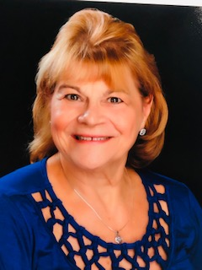
Sue Holbrook
Emmanuel, Dearborn
Sue was on the Board of Education at Emmanuel, past Superintendent of Sunday School, Church co-secretary for the congregation, teaches Sunday School, is on the Altar Guild and runs the Easter Flower Sale.

Slide 13
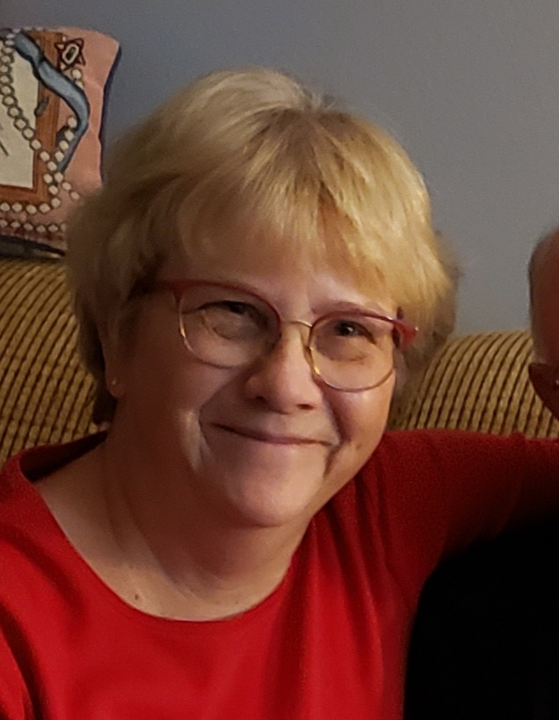
Diane Shay
Grace, Redford
Diane is a wonderful example of a positive Christian. She has served as a teacher in our Sunday School and remains a substitute. She and her husband both volunteer at Beaumont Hospital once a week. She helps every year with decorating Grace Lutheran for Christmas and the “not so fun task" of taking it down. She is faithful in worship and receives Word and Sacrament weekly.

Slide 14
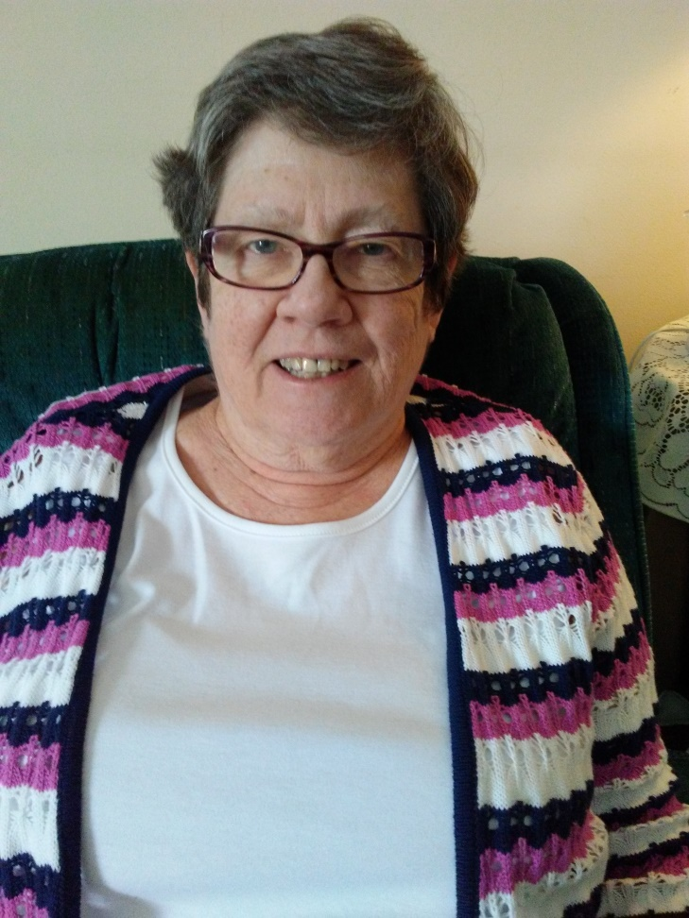
Kathleen Hintz
Guardian, Dearborn
For many years and in many ways, Kathy has served her Lord in the various ministries at Guardian Lutheran Church and School.

Slide 15
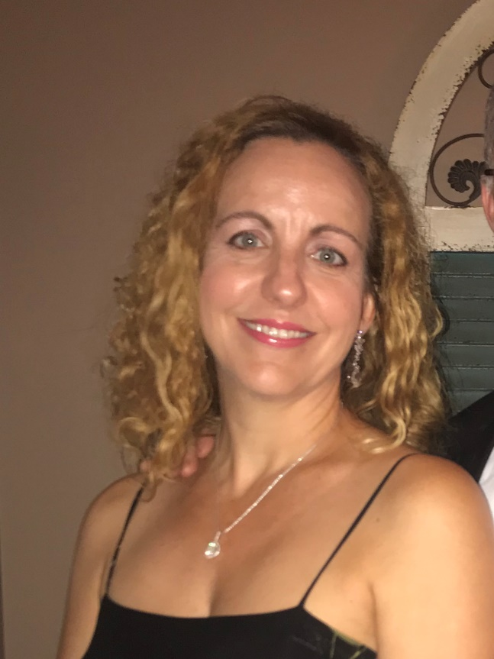
Stephanie Listman
Historic Trinity, Detroit
According to the Sunday School Director at Historic Trinity, Stephanie has been a tremendous help in every aspect of the Sunday School. She has even involved her husband Bill and their 2 daughters. She has directed The Nativity Story which has been presented during church services. Stephanie's charming personality has made her a real asset to our Sunday School Program.

Slide 16
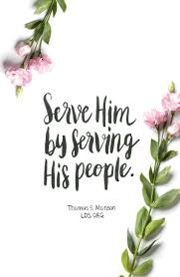
Joanne Gould Vollbrecht
Holy Cross, Warren
For over 20 years, Joanne has been a steadfast servant of our New Hope Food Pantry - picking up food from the Macomb warehouse, shopping, calling clients to schedule pick ups, and distribution. She is also a charter member of the Holy Cross Quilters who have met twice a month for 18 years to make quilts for Lutheran World Relief.

Slide 17
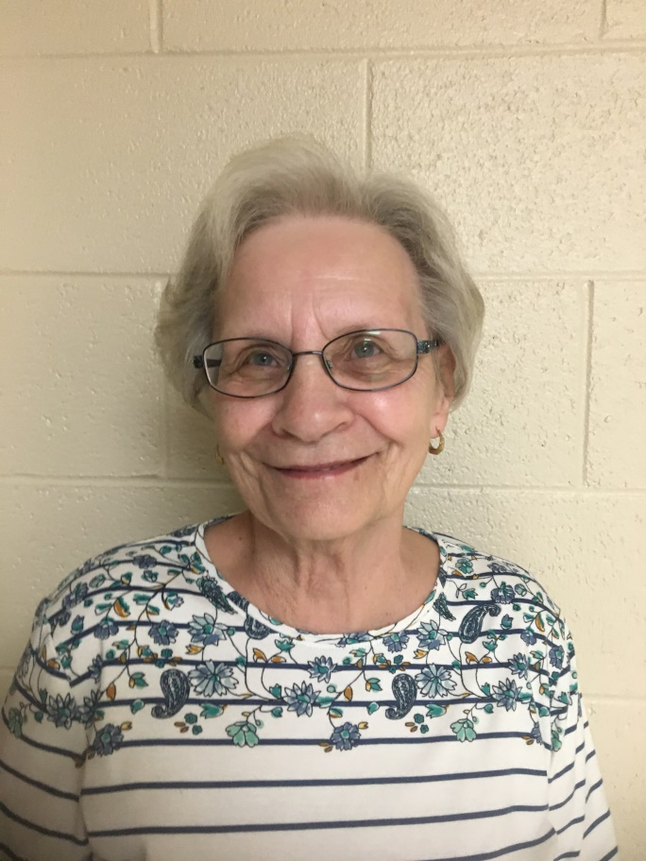
Lois McCarty
Hope, Warren
Lois McCarty is a volunteer after God’s own heart. She always cheerfully accepts the call for cooking, cutting, tutoring, teaching, assisting, and encouraging with love.

Slide 18
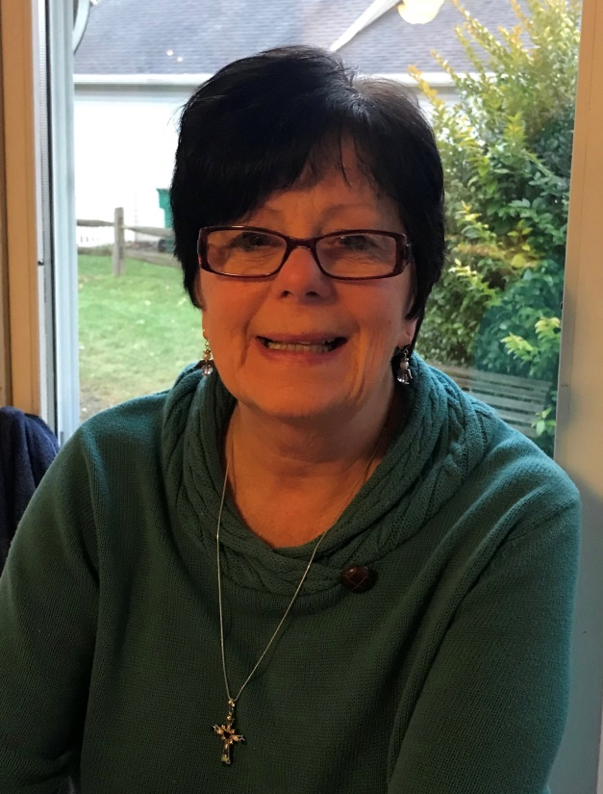
Terri Siladke
Hope, Warren 2021
Terri has been our MCREST Coordinator for over 20 years, along with willingly serving on the Mission Team and helping with Caring Servants Team projects.

Slide 19
Linda Davis
Huntington Woods Lutheran, Huntington Woods
Linda has served our congregation faithfully for many years. It often seems as though she knows all, sees all, loves all, and cares for all. Linda’s willing ears, helpful hand, and eager enthusiasm helps those who are new among us to feel welcome and those who have need feel comfortable in receiving our aid. The Lord has truly blessed us with someone so willing to serve Him and shine His light and love in all she does.

Slide 20
Rebecca Lundgren
Mt. Calvary, Detroit
Rebecca is a daughter of our congregation who has returned to her roots, making a commitment to get her teenage children confirmed and setting an example for her teenagers and kindergartner. Rebecca and her children have been volunteering with Camp Restore Detroit and Mt. Calvary's ministry outreach activities such as Easter Fair, VBS and Craft Nights for our head start families.

Slide 21
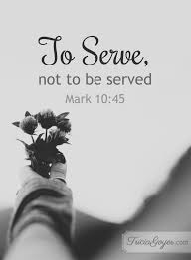
Amy Sander
Our Redeemer, Washington
Amy is a very devout woman of God. She has a very jubilant personality. This enables her to share the word of God in such a way that you know she is filled with the Holy Spirit. Amy can quote you scripture in any situation.

Slide 22
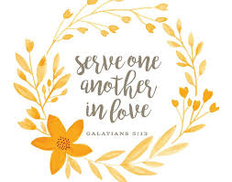
Barbara Hynes
Our Shepherd, Birmingham

Slide 23
Diana Schultz
Our Shepherd, Birmingham 2021

Slide 24
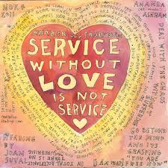
Janice May
Outer Drive Faith, Detroit
Janice is a quiet, spirit-filled servant for the Lord who is always eagerly helping whenever and where ever needed. She is dedicated to her family and church and cares for her grand nephews. Janice is a cheerful and dedicated Christian woman.

Slide 25
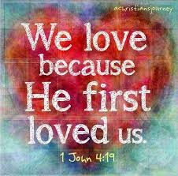
Sandra Blair
Prince of Peace, Farmington Hills
Sandra serves in many ways. She helps co-chair the Board of Fellowship using her gift of hospitality and cooks great food with her husband, John. She assists with Altar Guild as well as having the heart to be willing to serve the Lord in many ways. She is the mother of 3 adult children. Her son Matthew recently trained as a reservist in the military.

Slide 26
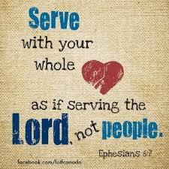
Cathy Hardy
Salem Lutheran, Westland
Cathy has been a spirited person to Salem meaning she knows the Bible and is quite an asset to our Women’s Bible study as a leader. She is quite involved with LWML. She has always been a volunteer as deaconess, financial assistant and working in many other ways at Salem. She is also secretary of our Woman’s Guild.

Slide 27
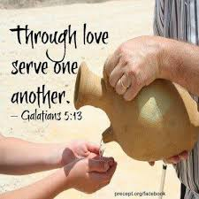
Angela Wenz
St. John Lutheran, Fraser
Angela is always ready to help the elderly and others who need help. She is also one of the chairmen for the St. John Rummage Sale.

Slide 28
Stephanie Krueger
St. John Lutheran, Taylor
Stephanie is a willing and faithful servant of the Lord. She serves as our Parish Administrator and as President of the VFW Ladies Auxiliary she helps veterans with their needs and concerns.

Slide 29
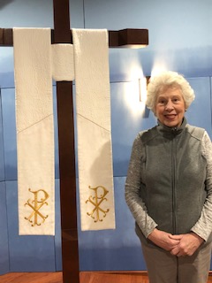
Linda Strausbaugh
St. Luke, Ann Arbor
Linda is a member of Living Water Church but participates in the LWML society of St. Luke Ann Arbor. She currently serves as both Co-Chair and Secretary. She is active in Women's Ministry at Living Water and is currently a ministry leader, helping to organize family events and women's get-togethers that have focused on both the church and the community. Linda is a volunteer extraordinaire. She desires the best for her church and the community and is willing to do what it takes.

Slide 30
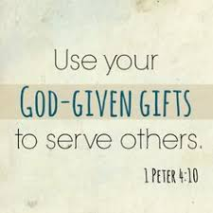
Pamela Kulczycki
St. Luke Lutheran, Clinton Township
Pam serves her Lord and church in many ways. She cleans the church altar, works on funeral lunches and many other things. She is the past treasurer of the Ladies Guild; she attends Bible study and church regularly. She is a mother and grandmother and is a loyal Christian.

Slide 31
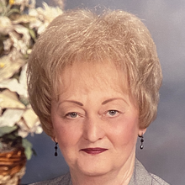
Ann Marie Confer
St. Matthew Lutheran, Westland

Slide 32
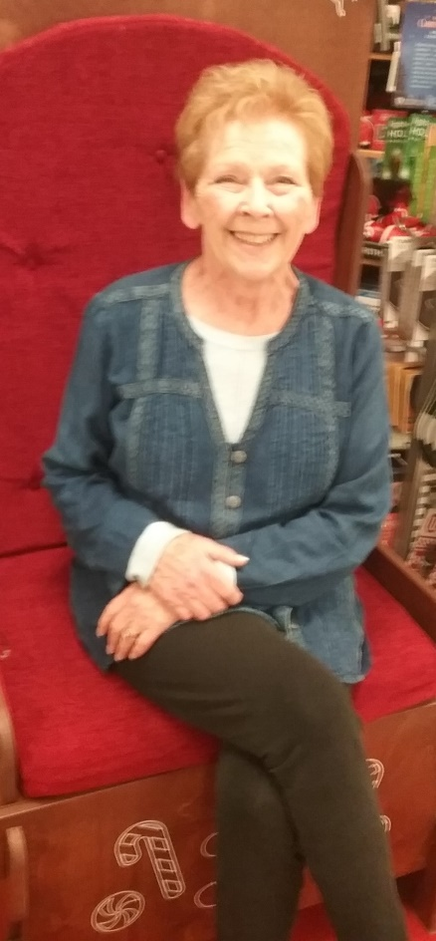
Shirley Mills
St. Michael Lutheran, Wayne
Shirley has quietly served Christ by generously donating her time, talents and treasure for the forty plus years she has been a member of St. Michael. She has confidentially kept the weekly offering accounts; producing member annual offering tax statements; and preparing labels and distributing offering envelopes for over 40 years. She has also volunteered for Lenten and Advent Dinners, Trunk or Treat, food donations for funeral, VBS and many other activities. Shirley truly serves the Lord and His people with love, gladness and humbleness.

Slide 33
Diane Hegenauer
St. Michael Lutheran, Wayne 2021
Diane is our fourth grade teacher. In addition to serving her students and their parents with love, compassion, and dedication during this year of the pandemic, Diane coordinated the Angel Tree Prison Ministry providing visits and gifts to over 50 children whose parents were incarcerated. Diane also serves with the Family of God ministry in Detroit and the Salvation Army. Diane is a strong leader, hard worker, and a humble servant.

Slide 34
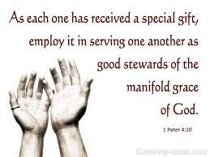
Rita McClatchey
St. Paul Lutheran, Royal Oak
Rita has been a teacher at St. Paul and finished her 40 year career as the principal. She organized and guided the school accreditation process. Rita is an active member of St. Paul Church.

Slide 35
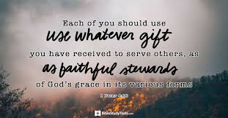
Debbie Smith
St. Paul Lutheran, St. Clair Shores
Debbie is an extremely artistic, compassionate, helpful lady who is willing to help when she can with whatever needs to be done. She is married and has 2 children.

Slide 36
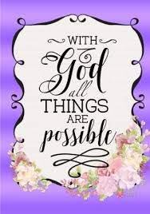
June Brown
St. Paul Lutheran, Sterling Heights
June is a long time member of St. Paul in Sterling Heights and has served in many capacities including choir, Altar Guild and Secretary of the Voters Assembly. She is much appreciated by her fellow members.

Slide 37
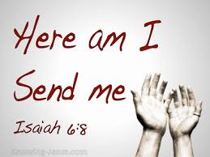
Michele Madigan
St. Peter Lutheran, Eastpointe

Slide 38
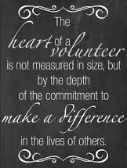
Brenda Schwark
St. Peter Lutheran, Macomb

Slide 39
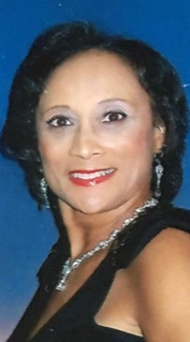
Sharon Ramsey Young
St. Philip Lutheran, Detroit
Sharon is a very wonderful person. She goes above and beyond for the youth. She also does an outstanding job when it’s time for gift giving or donations.

Slide 40
Caroline Henze
St. Thomas Lutheran, Eastpointe
Caroline is currently serving on the Altar Guild, helps with Soup and Sandwich Saturday events, volunteers in the Church Office and served as Treasurer for HIS II for a number of years at St. Thomas, Eastpointe.

Slide 41
Dawn Kivimaki
Shadow of the Cross, Farmington Hills
Dawn has been a member of Shadow of the Cross (formerly St. Paul ) for 30 years. She has a great love for teaching the word of God to children and has been a Sunday School teacher for 50 years, the Sunday School superintendent for 7 years. She is involved with SOTC Women’s League, VBS, Visually Impaired Ministry, Children's Hat and Glove Tree, and has been hired as the new Secretary for the Church and school. She and James have been married 52 years. They have one daughter, one grandson and 3 great-grandchildren.

Slide 42
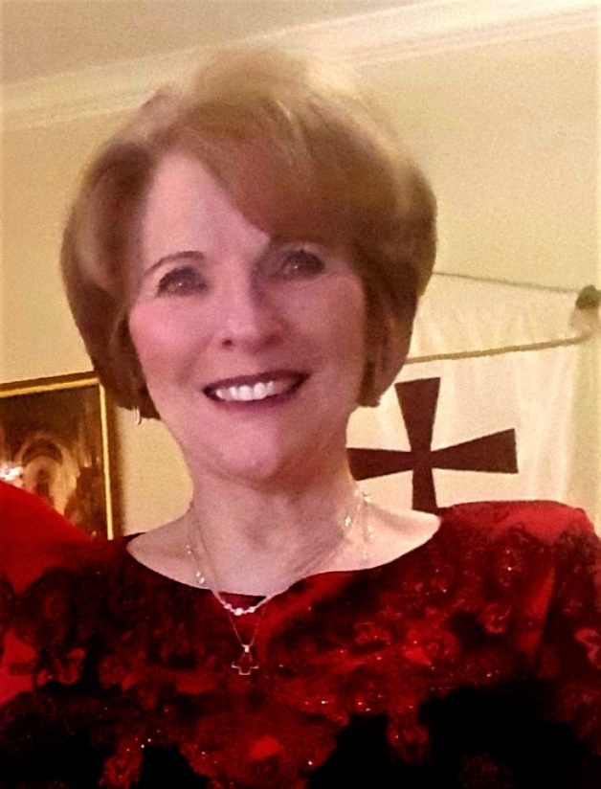
Kathy Zappitell
Trinity Lutheran, Utica
Kathy has been a member of Trinity for 37 years. She has been active in Trinity for Life, LWML, facilitator for the women's drop-in bible study and is a retired Lutheran grade school teacher. She has also taught Humanities/Art History at Wayne State University and Macomb Community College. Because religion was part of the course she could teach about the Reformation and spell out that we are saved by grace though faith in that secular setting.

Slide 43
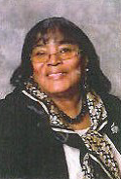
Shirley Cross
Zion Lutheran, Detroit
Shirley is a long time member of Zion. She is an active member of the Altar Guild and the Board of Parish Education. Every year she spends much of her time volunteering at the St. Michael's Liturgical Conference held at Zion in September. She always welcomes people at Zion with a smile and a hug.

Slide 44
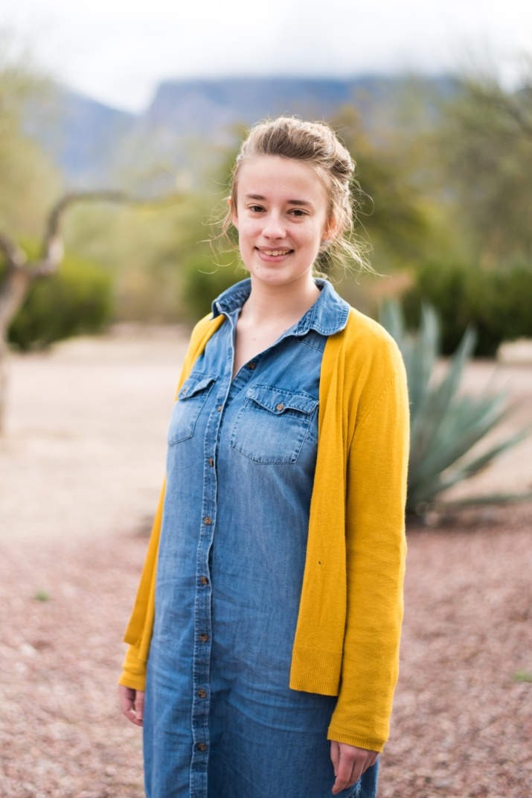
Bethany Mrosko
Camp Restore, Detroit
Bethany had been placed at Camp Restore Detroit as an intern to help prepare herself for a career of service in the LCMS. She embraced this opportunity by showing she can think outside the box, quickly identify new solutions and work hard to put them into play. She will be an asset to any congregation where she is sent to serve after her graduation in 2021 from Concordia University, St. Paul Minnesota.

Slide 45
Ruth Aufdemberge
Concordia Guild, Ann Arbor
Ruth Aufdemberge has and continues to radiate the Love of the Lord to all those around her through various volunteer activities.
Since 1964, the 2nd year after Concordia Jr. College in Ann Arbor opened, Ruth has been an active member of Concordia Guild. In these 56 years Ruth has given generously of her time and talents to Concordia students and their parents, to faculty and employees, to Concordia Guild, to her church and community locally and at large.
She has made birthday cakes and fruit baskets; assembled "finals week" snack bags for students; and helped host welcoming teas, picnics, graduation, Boars head and concert receptions for their families. When the college first opened with no "extra funds", she helped sew drapery for the Manor house. She helped with craft fairs, apple sales, garage sales, and Manor tours to raise money for scholarships. Faculty have enjoyed activities that Ruth hosted or assisted, such as costume parties, potlucks, appreciation breakfasts, teas, Oktoberfests and picnics that encouraged fellowship within the Concordia "family."
Ruth has also touched other communities by traveling nationally to help with building projects with Labors for Christ, making quilts for needy families plus volunteering with Faith in Action doing service projects in her own community.
Ruth has been used by God to be a blessing to many.

Slide 46
Patricia Skov
Concordia Guild, Ann Arbor 2021
Pat has supported Concordia University Ann Arbor as a student, alum, professor's wife, and Guild member. She is still consistently and quietly supportive in all she can currently do.

Slide 47
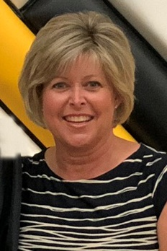
Alice Mueller
Lutheran High North Parents Team
Alice has been an active volunteer and supporter of LHN for the last 6 years. In June of 2020 she became the proud mother of 2 graduates, Jacob and David. She has spent countless hours volunteering for the Mustang Spirit Club in multiple capacities including organizing all the volunteers.

Slide 48
Jennifer Teeling
Lutheran High Northwest

Slide 49
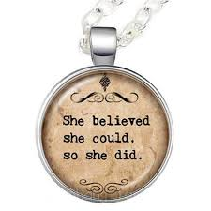
Sue Bavol
Lutheran High Westland Boosters
Sue is a cheerful servant of the Lord and Lutheran Westland. Her calm and positive demeanor makes her such a joy to work with. She is always willing to pitch in and she is great at problem solving. She shows so much kindness and concern to the students.

Slide 50
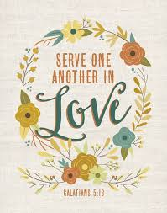
Debbie Day
Lutheran High Westland Boosters 2021
Debbie has been involved at Lutheran Westland for over 6 years. She currently serves as the Booster President. Debbie is always kind and has a positive attitude.

Slide 51
Janet Stechholz
Lutheran Special Education Ministries
Janet has been a faithful and valuable volunteer, working directly with LSEM students at St. Michael Lutheran School in Wayne, Michigan. Janet is making a big difference in the lives of children who have learning needs.

Slide 52
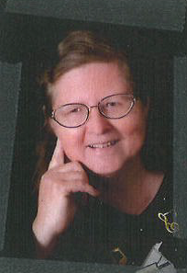
Andrea Anderson
LWML English District Greater Detroit Zone
Andrea is on the Zone Board. She takes the minutes at our meetings, she is a hard worker and asks questions. Andrea enjoys going to LWML District Conventions.

Slide 53
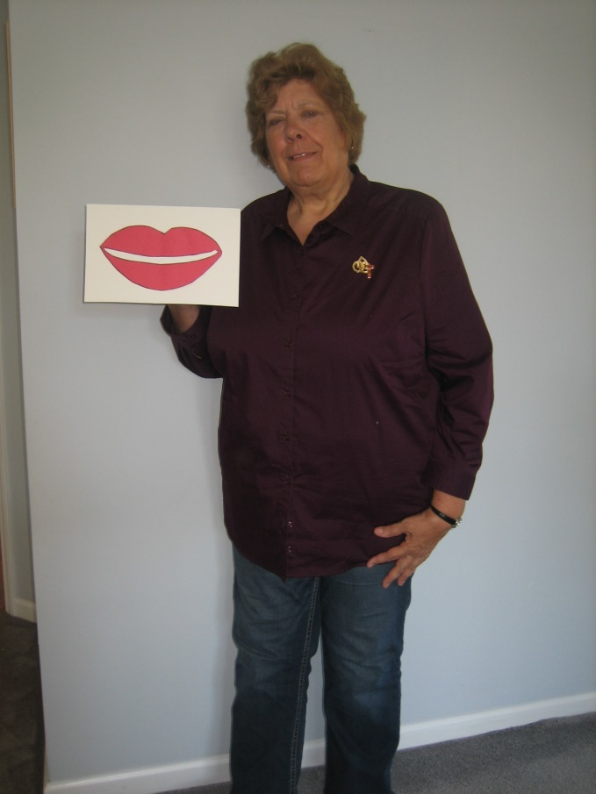
Karen McClelland
LWML Macomb South Zone 2021
Karen McClelland is an LWML leader with a faithful, giving, and compassionate heart. She has inspired the Macomb South Zone to always “Serve the Lord with Gladness”

Slide 54
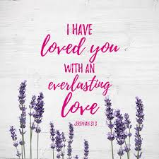
Deborah Dugan
MOST Ministries
Deb is an active member of her church and LWML. Last year she served on a MOST Ministries Short Term Mission Team that traveled to Tanzania to train impoverished young women to sew and market feminine hygiene pads and kits as part of a microenterprise project. She is also a tireless volunteer with MOST helping to refurbish some of the hundreds of donated eyeglasses each week.

Slide 55
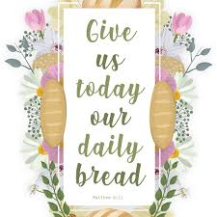
Ruby Yousef
POBLO

Slide 56
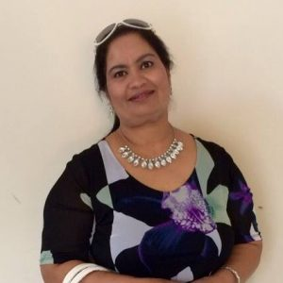
Pinky Dhuna
POBLO 2021
Pinky is a convert to Christianity from a Sikh background who serves the Lord as Poblo’s missionary to East Indian communities in the Metro Detroit Area. She will be attending the Heart 2 Heart Sisters’ training at the LWML National Convention this summer.

