Slide 1

Council of Lutheran Women
Welcome to the Annual
Council of Lutheran Women Luncheon!
Burton Manor
Livonia, Michigan
March 17, 2020

Slide 2

Council of Lutheran Women
“Well done, thou good and faithful servants.”
Congratulations and God’s richest blessings to the Council of Lutheran Women’s
2020 Women of the Year.

Slide 3
Council of Lutheran Women
For more than 50 years, the Council has united the efforts of affiliated Lutheran Women’s organizations, encouraging Christian witness and service in local communities.

Slide 4
Council of Lutheran Women
2019
Our Year in Review

Slide 5
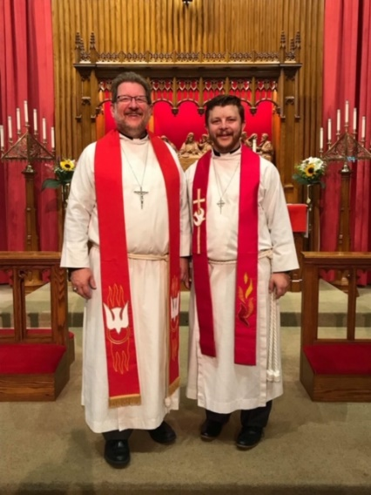
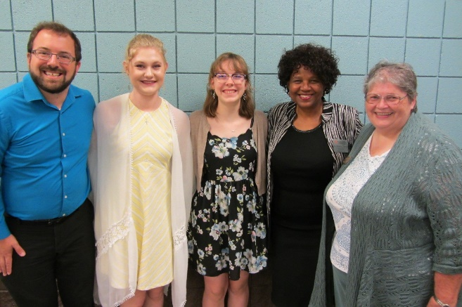
Council of Lutheran Women
Ministry Focus - Scholarships
Your participation today supports the Council’s Scholarship Program for LCMS seminarians and Concordia University Ann Arbor students.
In 2019, scholarships were awarded to 14 seminarians and two Concordia students.
Scholarship recipient Pastor Tim Smith
(front right) and his father Pastor Brad Smith, at his July 2019 ordination. Pastor Tim Smith is currently serving at Trinity Lutheran Church in Wausau, Wisconsin.
CLW President Lucie Witte congratulates CUAA student scholarship recipients Paige Rebber and Hannah Biermann, accompanied by Joshua Kittleman, Chair of the Family Life Program, and Dr. Sandra Harris, Dean of the School of Education.

Slide 6
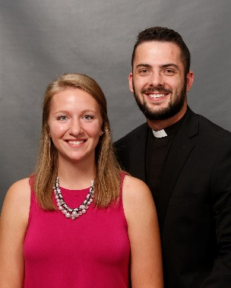
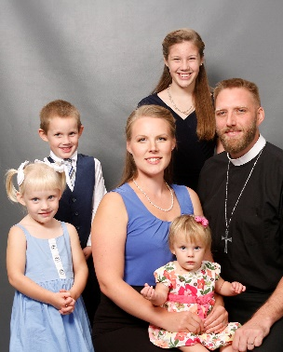
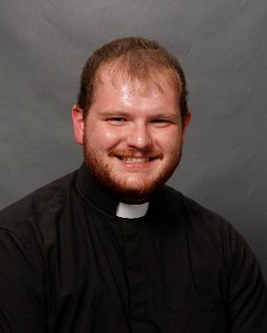
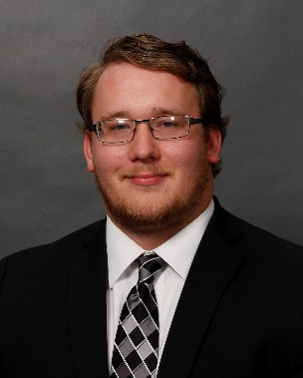
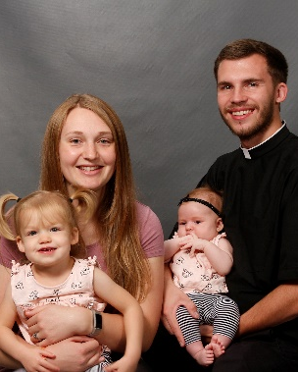
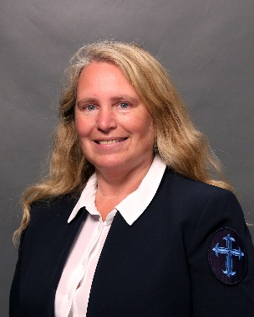
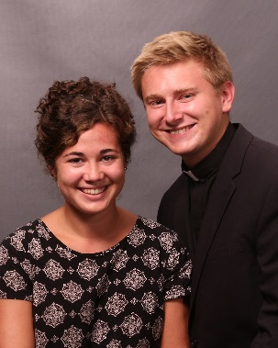

Thank you from your 2019 scholarship recipients at Concordia Theological Seminary, Fort Wayne!
Jakob Andrzejewski
Historic Trinity, Detroit
John Baseley
Emmanuel, Dearborn
Dane Breitang
Emmanuel, Dearborn
Nick Gapski
St. Peter, Eastpointe
Nathaniel Konkel
Christ the King, Southgate
Michele Madigan
St. Peter, Eastpointe
Dylan Smith
Christ the King, Southgate

Slide 7
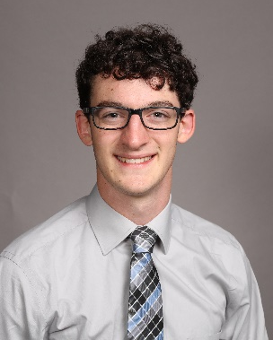
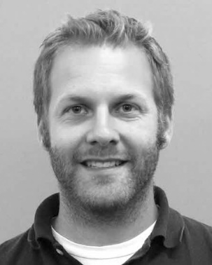
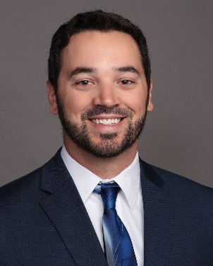
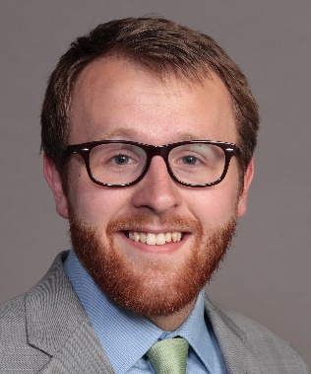
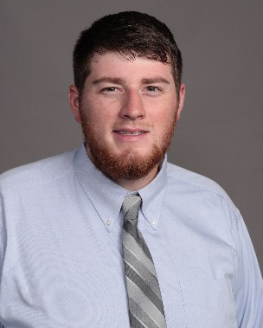
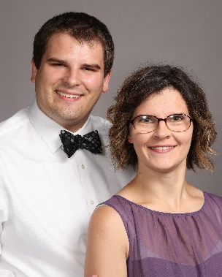
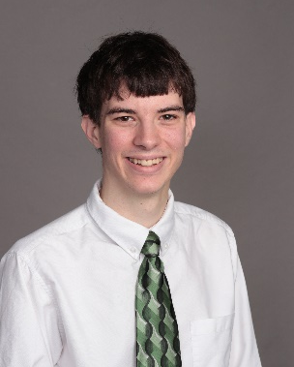
Thank you from your 2019 scholarship recipients
at Concordia Seminary, St. Louis!
Jacob Childers
Christ the King, Southgate
Tyler Cronkright
Christ Our Savior, Livonia
Richard Grunewald
Faith, Troy
Matthew Lorenz
St. Peter, Macomb
Hayden Lukas
Trinity, Utica
Andrew Simpson
Faith, Troy
Jacob Smith
St. John, Fraser

Slide 8


Thank you for your support of our students and for your partnership in the Gospel!

Slide 9
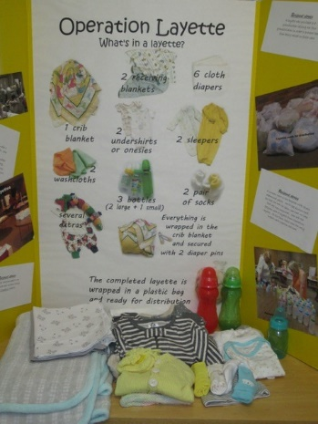
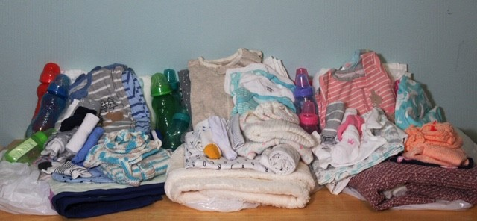
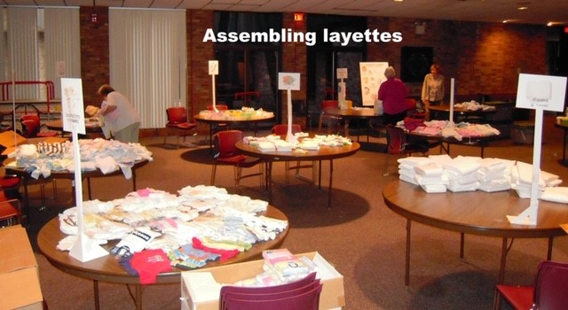
Council of Lutheran Women
Ministry Focus – Operation Layette
In 2019 38 layettes were assembled by the ladies of
St. Paul, Royal Oak, MI, and delivered to mothers in need.
The contents of layettes ready for distribution.
Volunteers assemble layettes to be distributed to St. Joseph Hospital in Pontiac and Image Clear Ultrasound, a mobile bus unit that serves metro Detroit and Warren.
Operation Layette table display taken to events to encourage donations and educate volunteers.

Slide 10
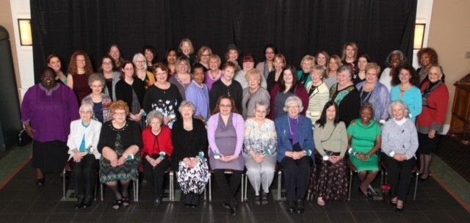
Women of the Year March 19, 2019
Council of Lutheran Women

Slide 11
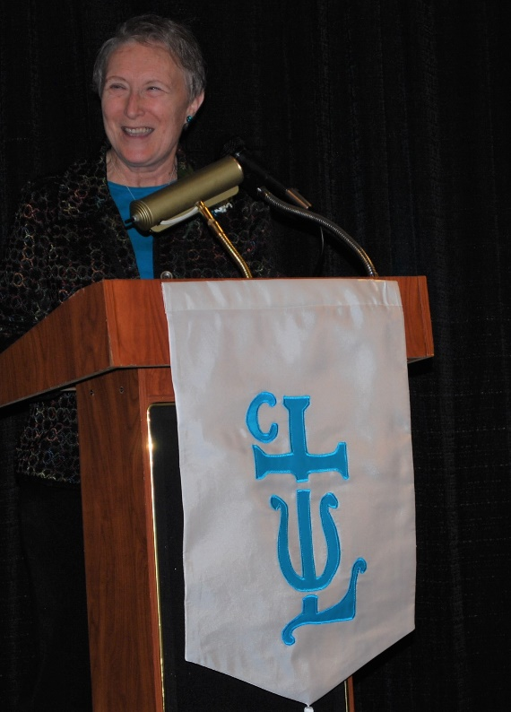
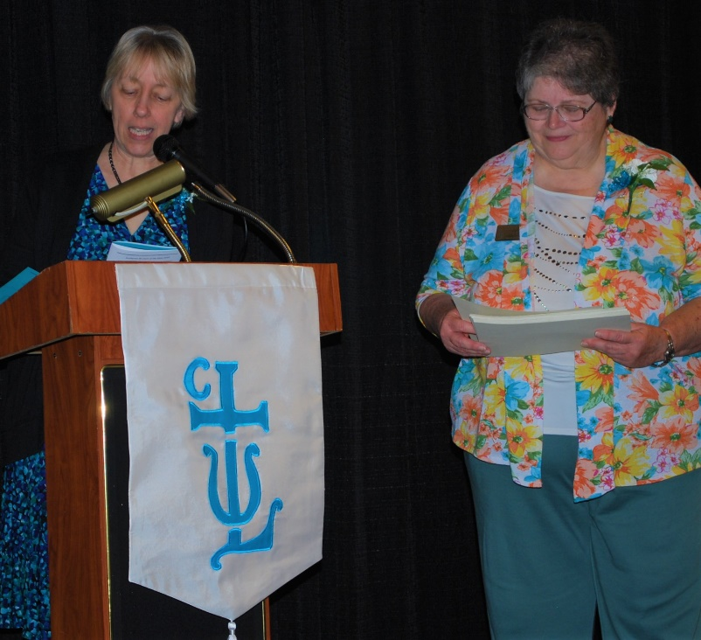
Council of Lutheran Women
Council of Lutheran Women Luncheon 2019
CLW President Lucie Witte and Doris August introducing each Woman of the Year
Mistress of Ceremonies Sandy Hardies

Slide 12
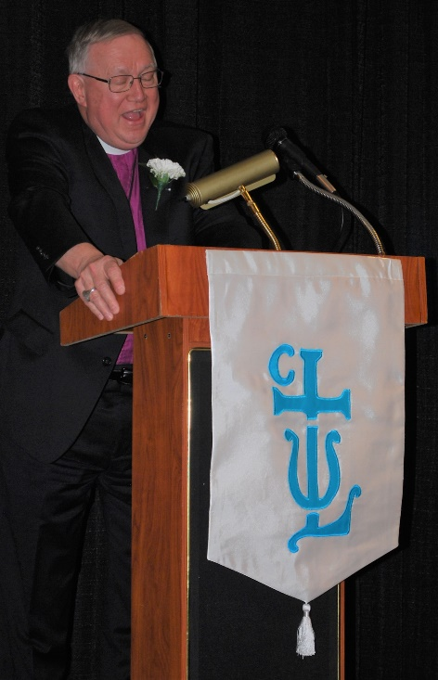
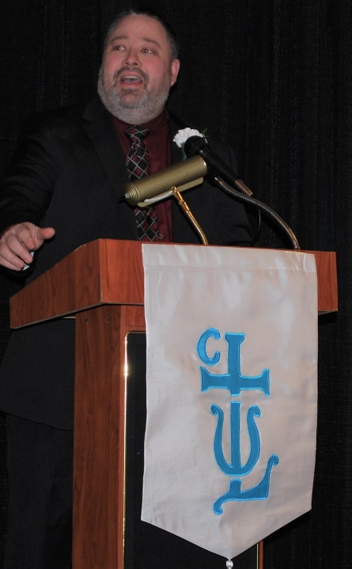
Council of Lutheran Women
Council of Lutheran Women Luncheon 2019
CLW Pastoral Advisor Pastor Dan Howard delivers the invocation.
Rev. David Stechholz delivers the Salute to the Women of the Year 2019.

Slide 13
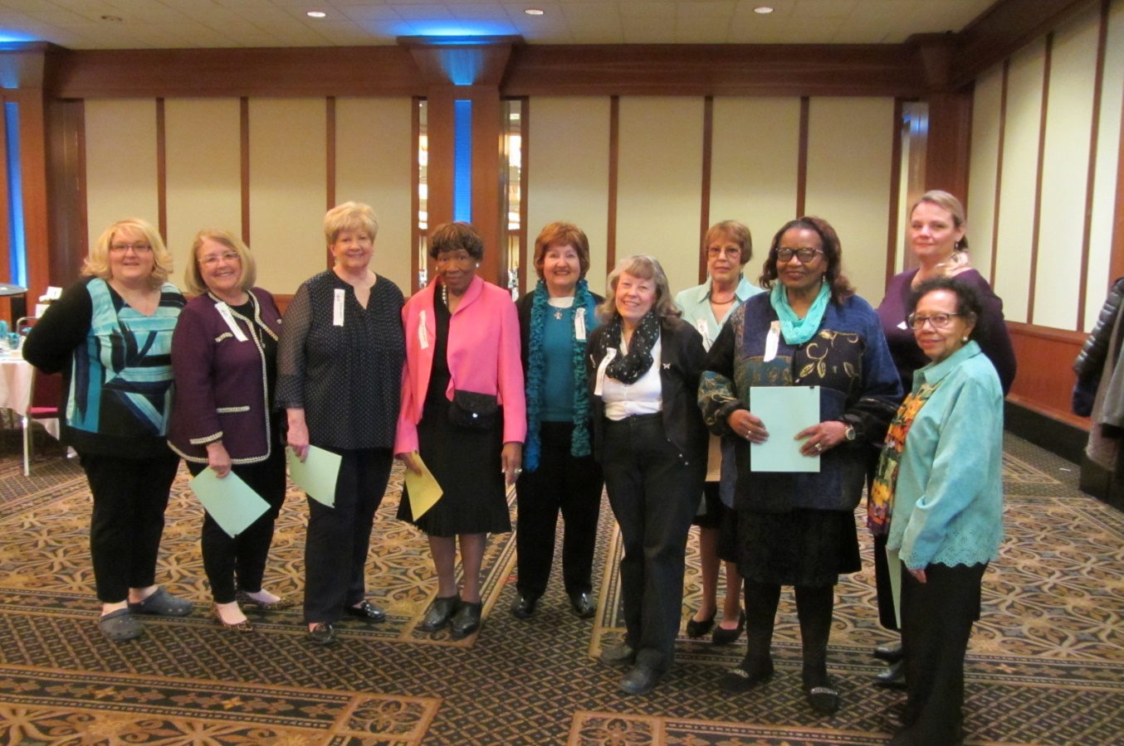
Council of Lutheran Women
Council of Lutheran Women Luncheon 2019
Council of Lutheran Women Luncheon Hostesses who volunteered to assist attendees (l to r): Sheri Comeford, Sharlon Franke, Claudia Crawford, Annie Edwards, Carol Wilkins, Karen Linzing, Judy Shepard, Elma Dixon, Shelly Manor, and Ann Brooks.

Slide 14
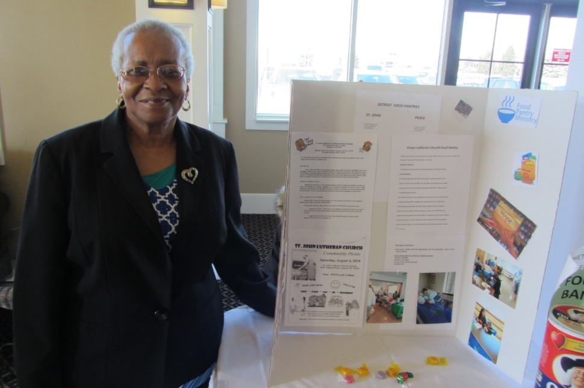
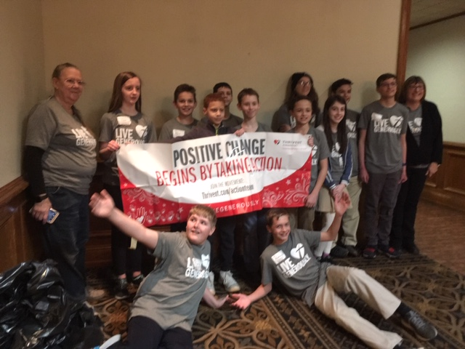
Council of Lutheran Women
Council of Lutheran Women Luncheon – Ministry Focus
Food Bank volunteer Ivy Thompson displays information about local food bank operations.
Students and volunteers from Guardian Lutheran School in Dearborn help gather and sort donations received for those in need.

Slide 15
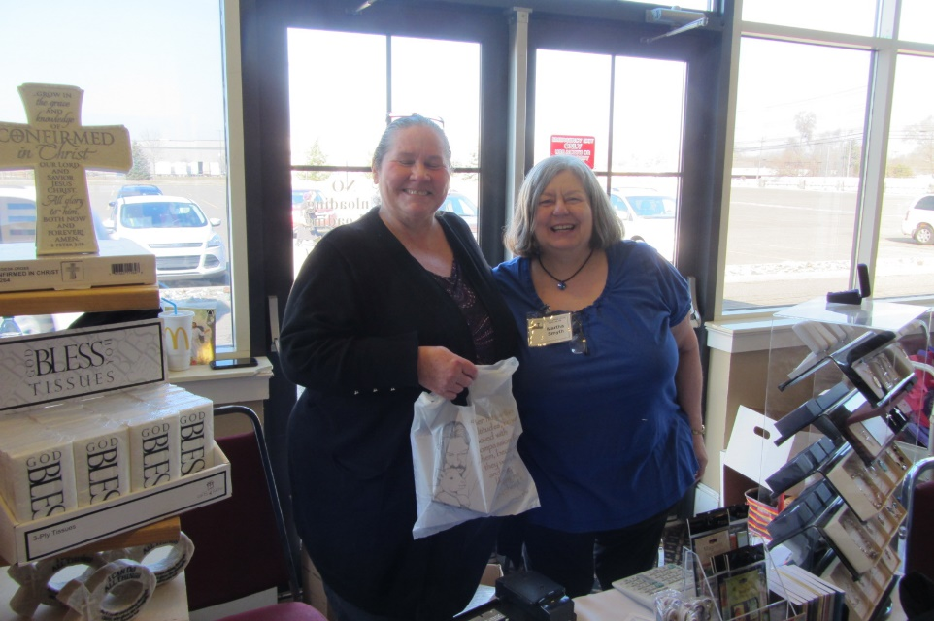
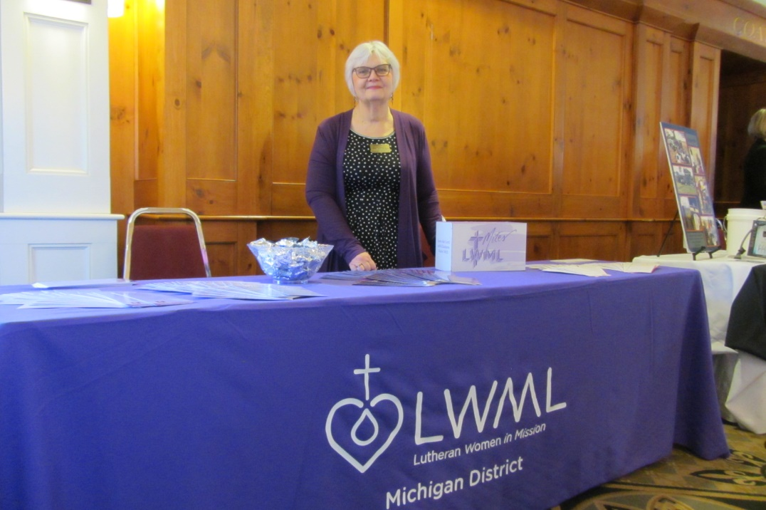
Council of Lutheran Women
Council of Lutheran Women Luncheon – Ministry Focus
Lutheran Bookstore – Julie Friend and Martha Smythe
Lutheran Women’s Missionary League Michigan District – Marsha Marshall

Slide 16
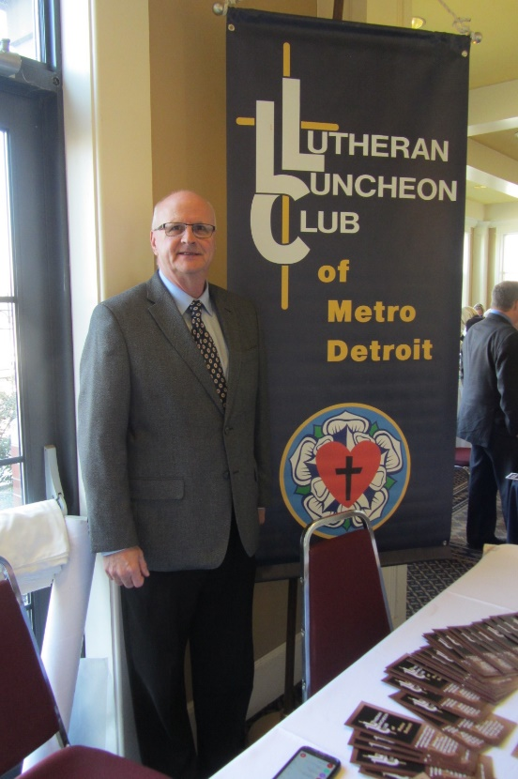
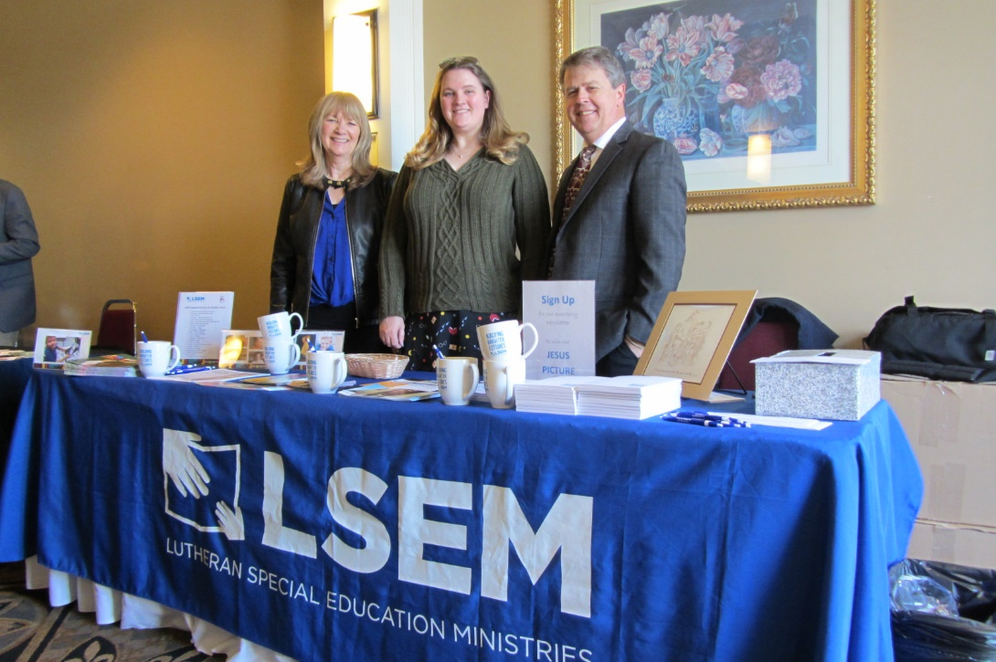
Council of Lutheran Women
Council of Lutheran Women Luncheon – Ministry Focus
Lutheran Special Education Ministries – Grace Lorano, Caitlin McCallum and Marty Moro
The Lutheran Luncheon Club of Metro Detroit – Randy Goddard

Slide 17
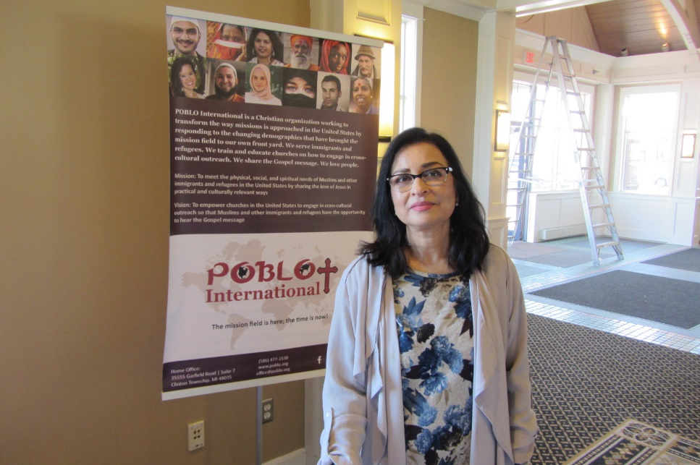
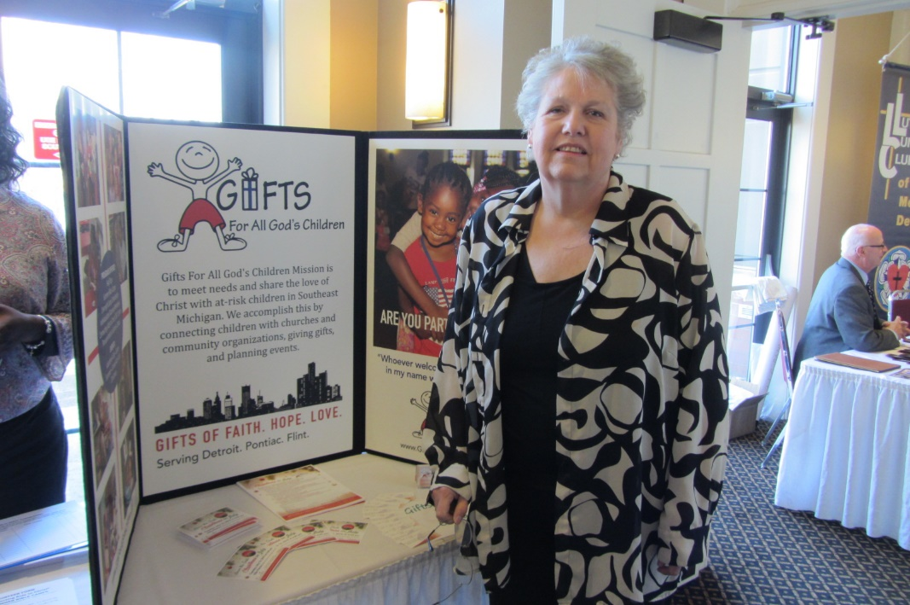
Council of Lutheran Women
Council of Lutheran Women Luncheon – Ministry Focus
POBLO International – Cynthia Khan
Gifts for All God’s Children – Pat Sanders

Slide 18
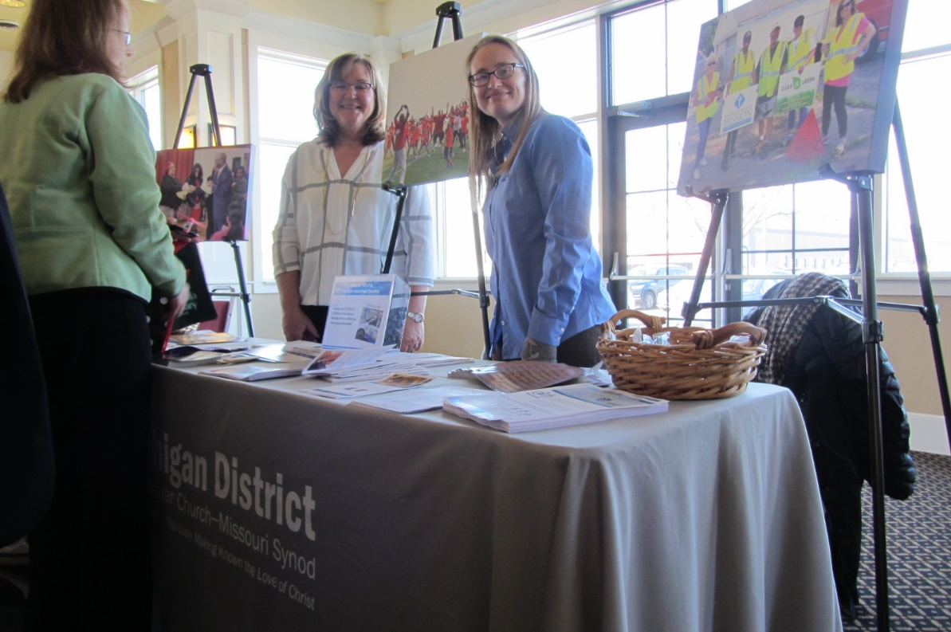
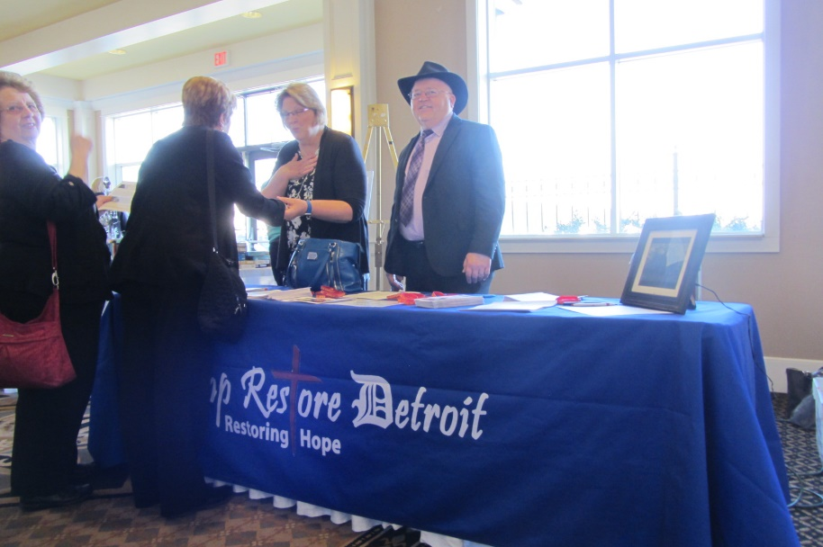
Council of Lutheran Women
Council of Lutheran Women Luncheon – Ministry Focus
Lutheran Church – Missouri Synod
Michigan District – Deb Fall and Linda Ekong
Camp Restore Detroit – Lori and Pastor John Carrier

Slide 19
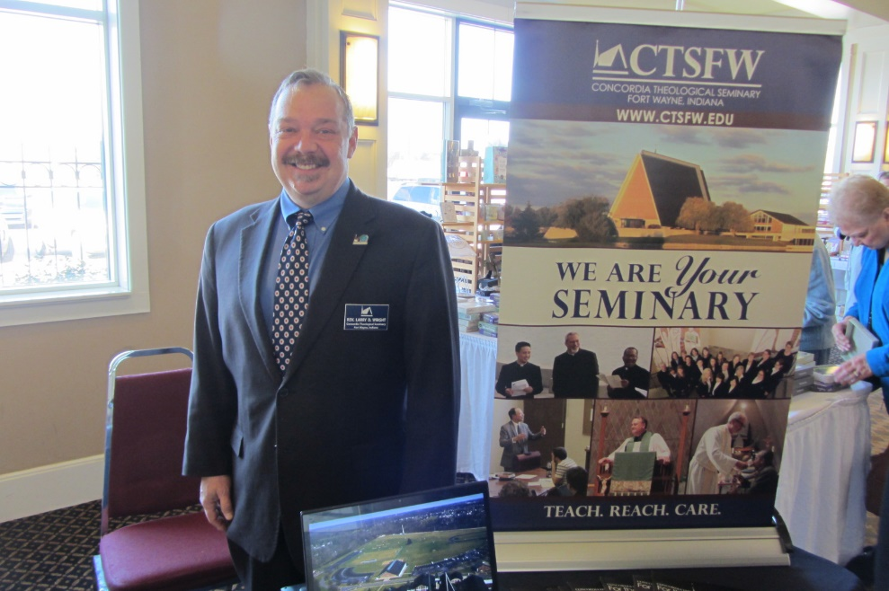
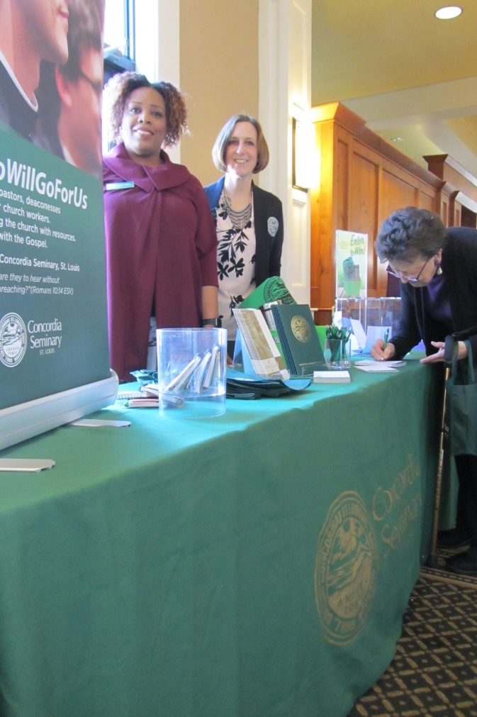
Council of Lutheran Women
Council of Lutheran Women Luncheon – Ministry Focus
Concordia Seminary, St. Louis – Melodie Bostic and Laura Thomas
Concordia Theological Seminary, Ft. Wayne – Rev. Larry Wright

Slide 20
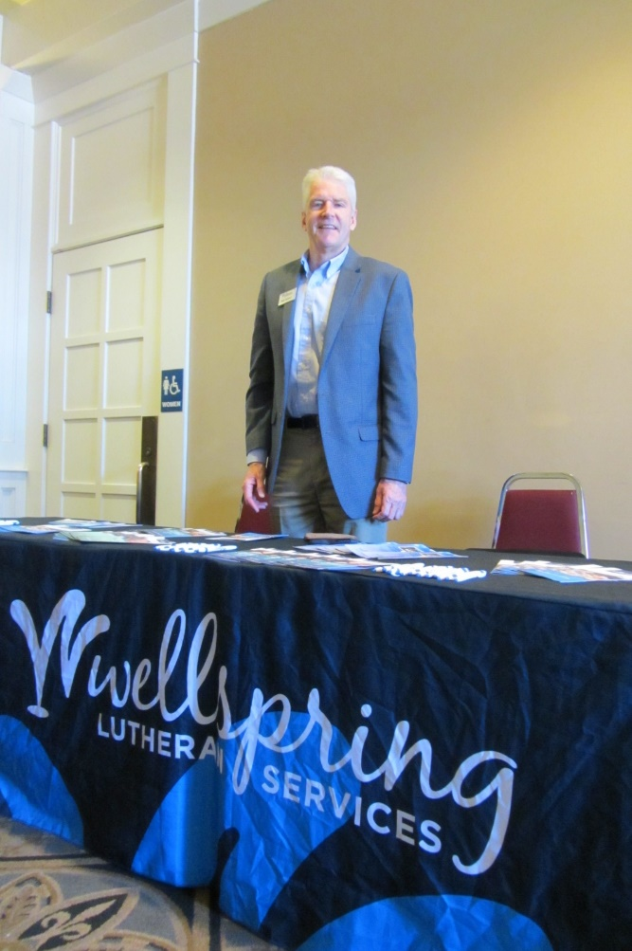
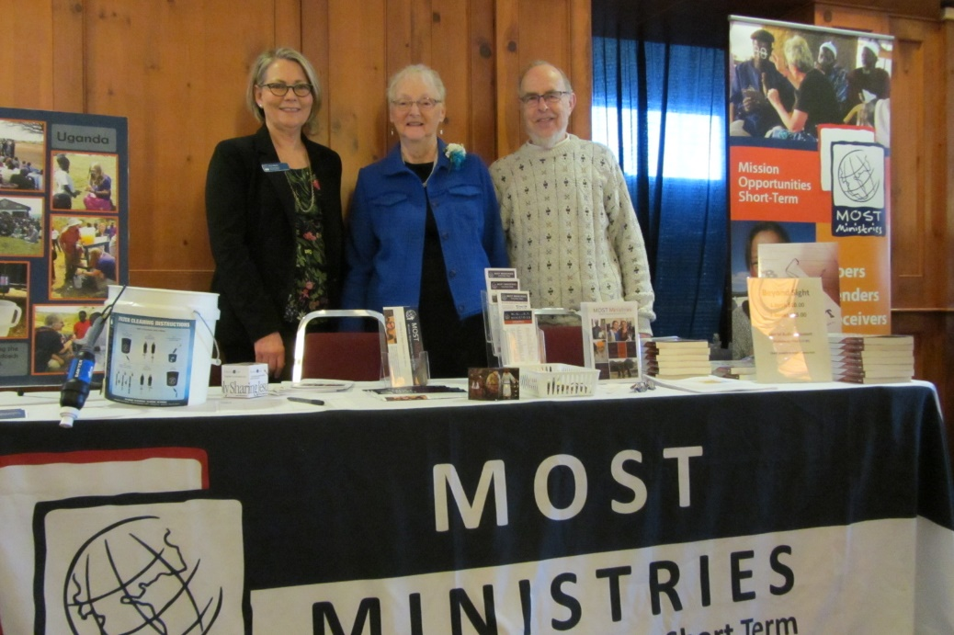
Council of Lutheran Women
Council of Lutheran Women Luncheon – Ministry Focus
Wellspring Lutheran Services – Mike Redford
MOST Ministries – Ruth Martin, Gayle and Don Sommerfeld

Slide 21
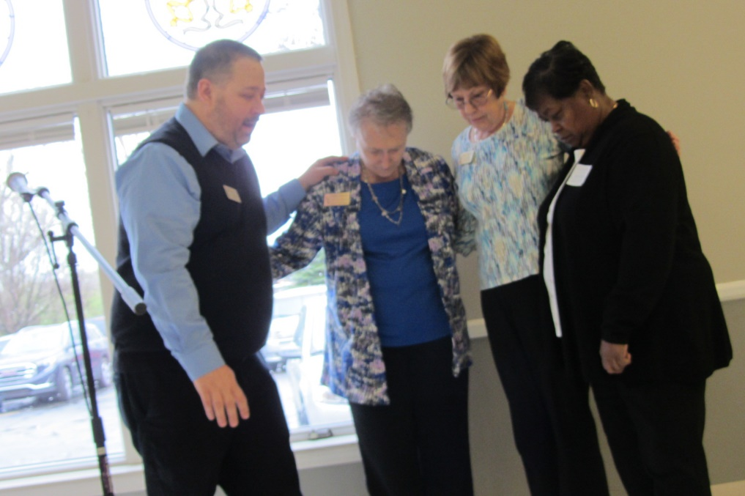
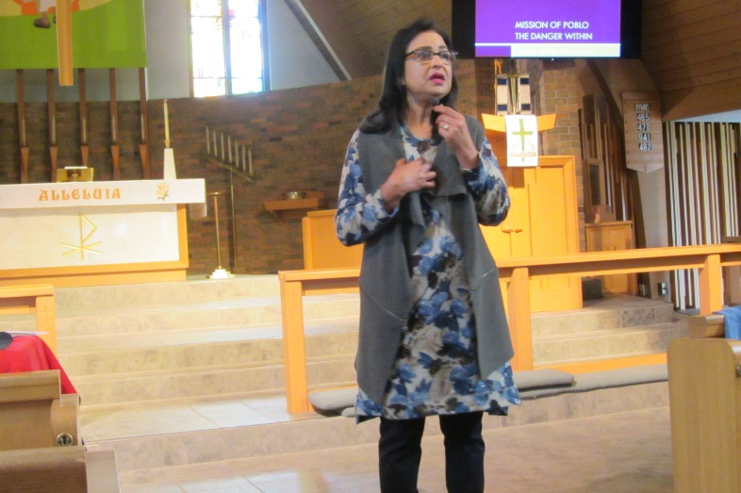
Council of Lutheran Women
Spring 2019 Meeting
St. Matthew, Westland, MI
Cynthia Khan of POBLO is the featured speaker.
Pastor Dan Howard prays for newly elected and installed CLW officers (from left) Vice President of Events Sandy Hardies, Vice President of Communication Judy Shepard, and Recording Secretary Charlestine Gooden.

Slide 22
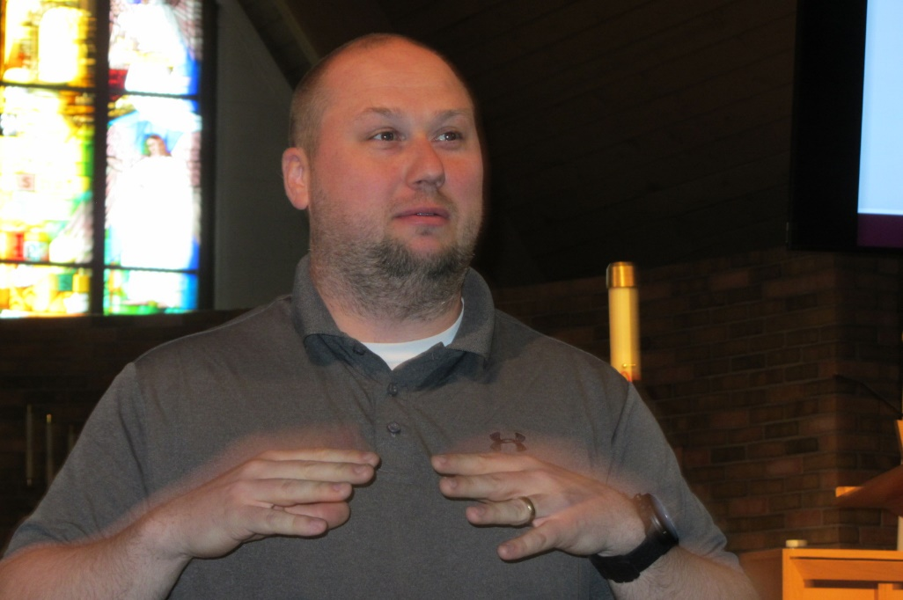
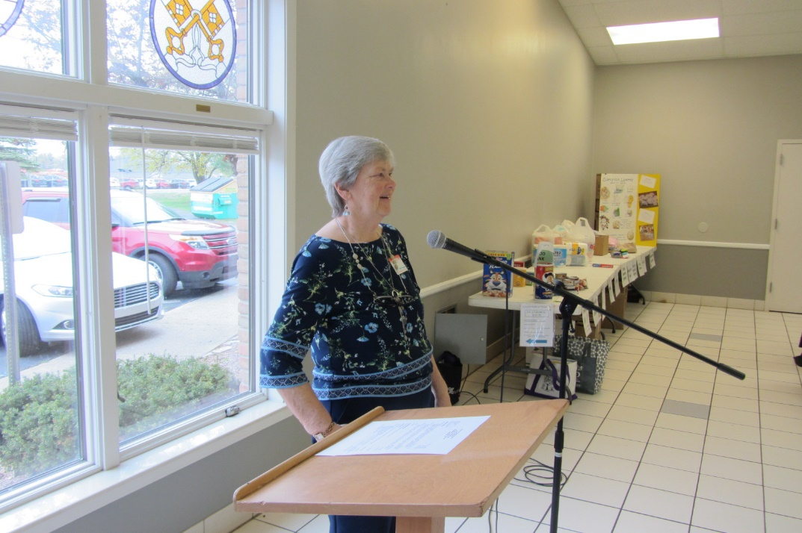
Council of Lutheran Women
2018 Spring Meeting
Judy Hackerd welcomes CLW to St. Matthew, Westland.
Principal Dan Burk delivers the closing devotion and prayer.

Slide 23
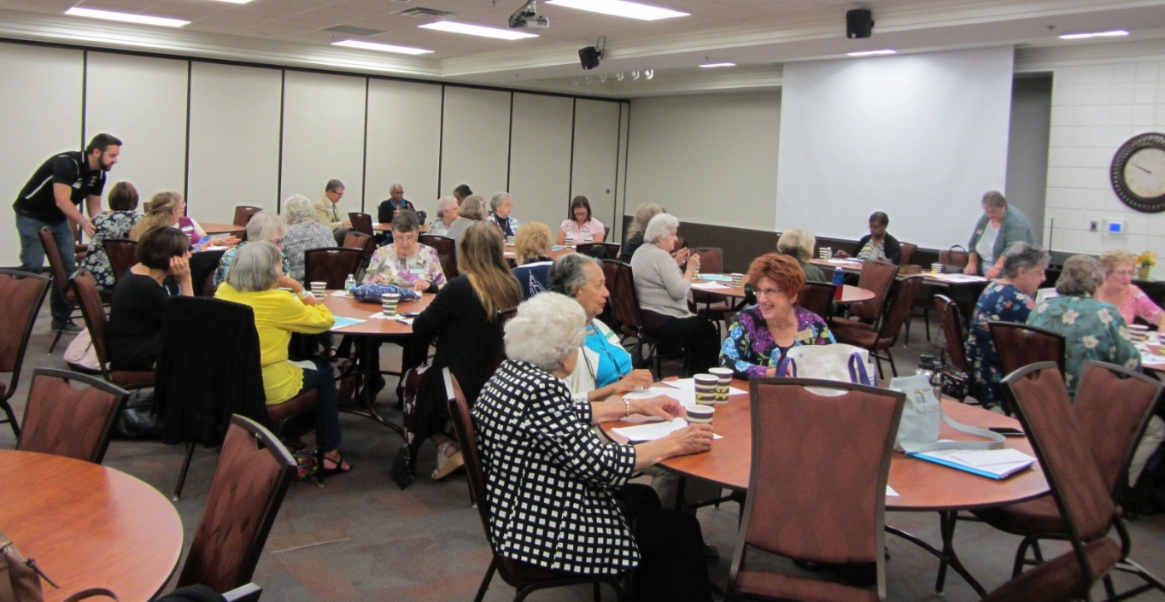
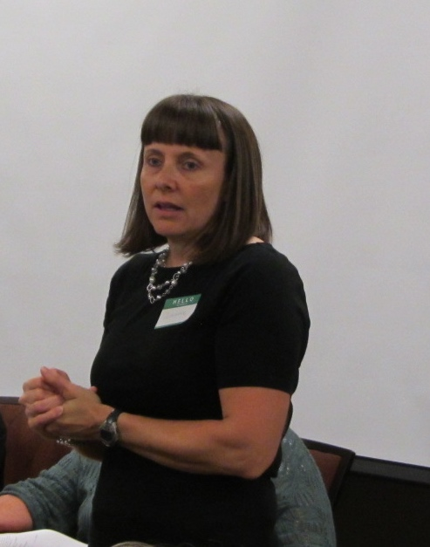
Council of Lutheran Women
Fall 2019 Meeting
St. Peter Lutheran Church, Macomb, MI
Fellowship before the meeting
Welcome from St. Peter

Slide 24
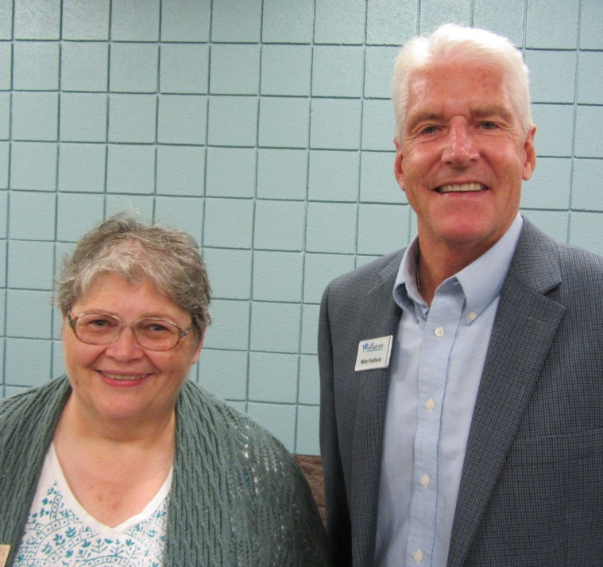
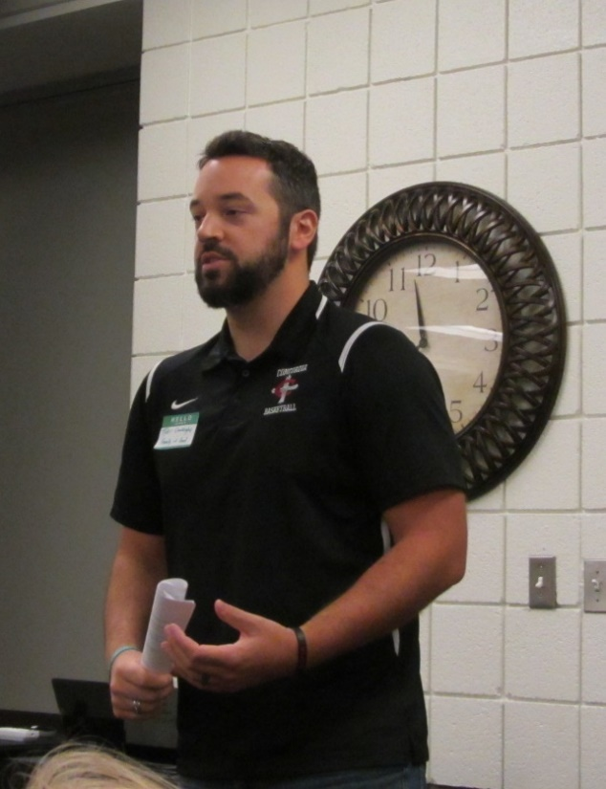
Council of Lutheran Women
2019 Fall Meeting
SMP student and scholarship recipient Tyler Cronkright (Family of God, Detroit) thanks CLW for its financial and prayer support.
President Lucie Witte thanks speaker Mike Redford of Wellspring Lutheran Services.

Slide 25
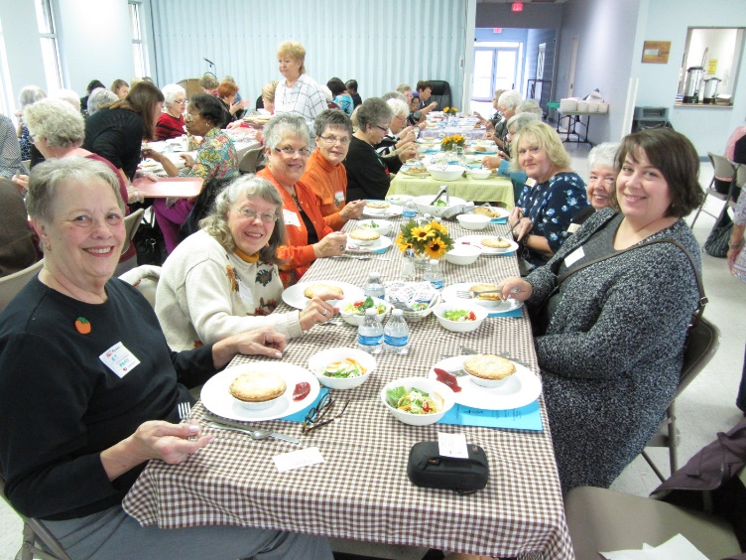
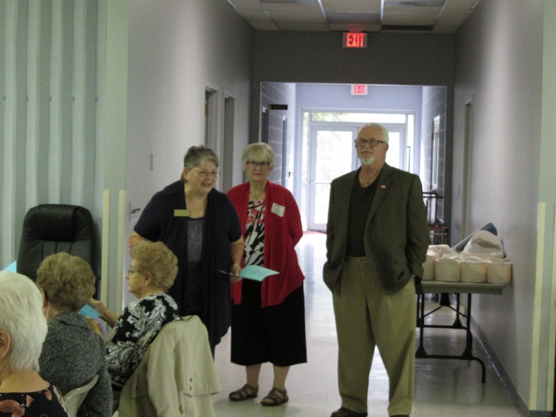
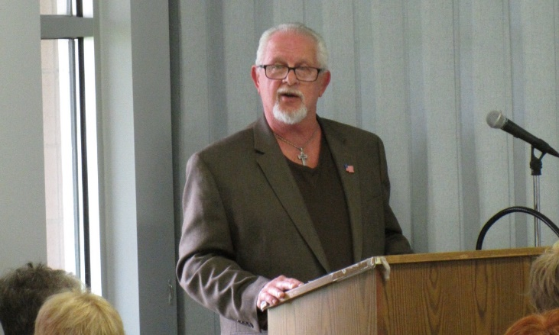
Presidents Tea 2019
Holy Cross Lutheran Church, Warren, MI
Council of Lutheran Women
A lovely lunch prepared by the women of Holy Cross
Devotion and prayer by Deacon Tony
Welcome by President Lucie Witte and Linda Conger

Slide 26


Council of Lutheran Women
2019 Presidents Tea
Entertainment was provided by the Lutheran High North Instrumental Flute Choir under the direction of Mr. Jared Brown.

Slide 27

Council of Lutheran Women
Thank You!
Council of Lutheran Women Board of Directors

